Slide 1
Albemarle County Public Schools
Fiscal 2014-2015 Audited Review

Slide 2
FY 2014-2015 Background
Culture of Cut
  Two years of holdback being released very late or not at all
  Multiple year of budget cut discussions
  Higher enrollment / Potentially greater expenses
  Low staff turnover / High benefit costs
  Depletion of reserve accounts
Low Fund Balance
  Objective to rebuild fund balance

Slide 3
Pre-Audit vs. Audit Changes
Item | Pre-Audit (October 6th) | Final Audited | Difference
State Revenues* | $45,306,767 | $44,822,472 | -$484,295
Federal Revenues | $3,015,144 | $3,017,549 | +2,405
Local Revenues | $113,685,856 | $113,685,300 | -$556
Expenditures | $159,119,424 | $159,125,743 | +$6,319
Total change of addition to fund balance from Pre-Audit to Audit: |  |  | -$488,765
Item | Pre-Audit (October 6th) | Final Audited | Difference
Addition to Fund Balance | $2,888,343 | $2,399,578 | -$488,795
*Auditors required revenue moved to FY15-16 even though expense was booked in FY14-15. This was due to the substantive delay of the reimbursement from the State.

Slide 4
FY 2014-2015 Revenues
Overall Revenues ~$100K more than projected
State Revenues:
  $273,000 more than projected
    106 more students than projection
    Sales tax and basic aid increases
Small Federal and Local Changes

Slide 5
FY 2014-2015 Expenditures
Overall Additions to Fund Balance: $2.3M (1.5% of Budget)
Compensation Savings: $1.05M (0.7% of Budget)
    Includes all compensation and benefit line items for K-12 salary account and departments.
    Includes “other wages and benefits” from departmental accounts
Operations Savings: $1.3M (0.8% of Budget)

Slide 6
FY 2014-2015 Compensation
Savings: $1.05M (0.7% of Budget)
  ~500K Teacher Salary Savings
    Retirements, Turnover and Lag in Hiring
  ~$125K Savings for Unfilled Assistant Superintendent position
  ~$345K Savings in Building Services
    Unfilled vacancies due unusual turnover/difficulty hiring qualified workers
  ~$125K Additional Savings in Other Accounts

Slide 7
Operations
Savings: $1.3M (0.8% of Budget)
Major Contributors
  PREP/SPED Savings ($427K)
  Schools Savings/Carryover ($349K)
  Overall Instructional/Tech Departments Savings ($236K)
  Insurance Savings ($136K)
  Board Reserve ($58K)
  Employee Services ($50K)
Notes:
2111 – $38K – Food, Contract SVS
Fed Pgs – $77K – IP, Staff Development
Media – $31K - Equipment
DART – $52K – Data lines, testing materials
PD – $36K – Staff Development
HR – Health Services, Consultants, Employee inoculations

Slide 8
Fund Balance Review
Item | Amount
Audited Fund Balance as of June 30, 2015 | $3,916,010
Post-Audit Adjustment for Inventory | $32,876
Current Budgeted Use of Fund Balance | ($1,623,967)
Existing Unencumbered Fund Balance | $2,324,919

Slide 9
Recommended Use of Fund Balance
Item | Amount
Reserve for Health Insurance Fund | $1,200,000
Replenish the CSA Fund* | $200,000
Establish Revenue Reserves | $500,000
Total Recommended Use of Fund Balance | $1,900,000
*Requires School Board and BOS Action

Slide 10
Fund Balance Review
Item | Amount
Audited Fund Balance as of June 30, 2015 | $3,916,010
Post-Audit Adjustment for Inventory | $32,876
Current Budgeted Use of Fund Balance | ($1,623,967)
Existing Unencumbered Fund Balance | $2,324,919
Superintendent’s Recommendations | ($1,900,000)
Available Fund Balance After Implementing Recommendations | $424,919

Slide 11
Recommendations/Actions
Hold $1.7M in fund balance as reserves for health care and revenue (does not require a vote)
Approve $200,000 in use of fund balance for CSA (requires vote)

Slide 12
Albemarle County Public Schools
Fiscal 2015-2016 Mid-Year Review

Slide 13
New Processes
Mid-Year Review and 3rd Quarter Reporting
  Reports will provide information on compensation savings associated with employee turnover and month to month projected cost savings associated with employee movement.
  3rd Quarter Reports (March) will provide compensation reporting as well as operational updates from departments/schools.

Slide 14
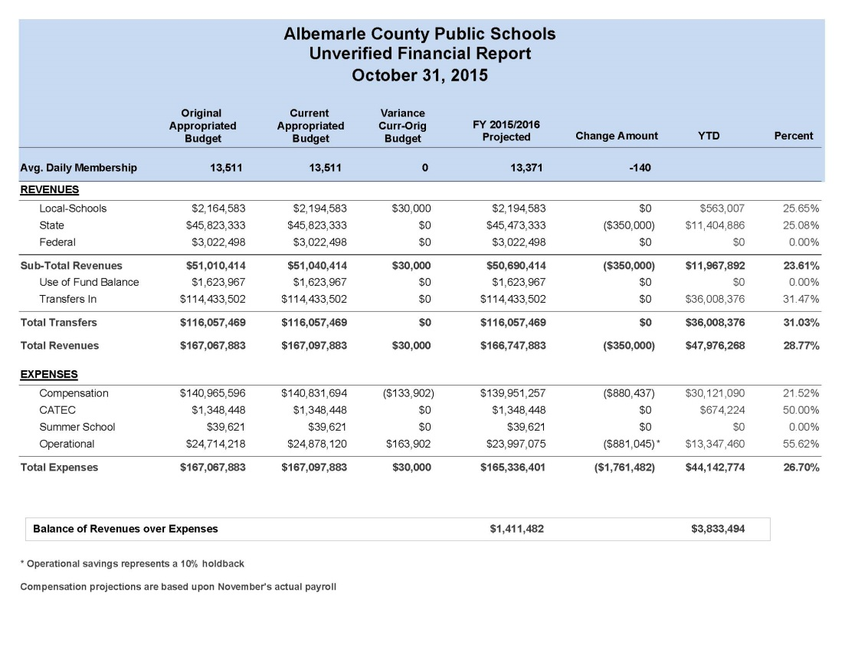
October 31, 2015 Financial Report

Slide 15
Year to Date Compensation Spending
Through October only 21.39% of compensation has been expended
Historically ~28% of total compensation is expended in the final two months of the fiscal year
Variances in staffing costs are not reflected until the end of the fiscal year
One percentage point on compensation is equal to $1.4M
Based upon November payroll the Division will have an additional savings of $880K (including the distribution of $657K to other areas)

Slide 16
Payroll Schedule Examples
November Payroll 2015
School Division allows for acceptance of different pay schedules for school-level based employees
10 month employees may elect to receive 12 paychecks
Groups | FTE | Months Worked | Checks Paid | Months Paycheck Received
Bus Drivers, Some School Office Staff, Nurses, Teachers and TA’s | 276 | 10 | 10 | September 2015 through June 2016
Teachers, TA’s, Bus Drivers, Nurses, School Office Staff | 1374 | 10 | 12 | September 2015 through June 2016 July 2016 paycheck booked in June 2016 August 2016 paycheck booked June 2016
Social Worker and Teacher | 2 | 11 | 11 | August 2015 through June 2016
Classified | 416 | 12 | 12 | July 2015 through June 2016
Notes:
VRS Change - paychecks

Slide 17
Monthly Compensation
12 Month Employees were paid in July 2015. In August 2015 both 11 month and 12 month employees receive paychecks.
September 2015 was the first month that 10 month employees receive their paycheck.
October 2015 was the first month classified employees received a partial increase.
November 2015 payroll was the first month where all classified employees will receive their full increase

Slide 18
Compensation Projections (Lapse)
Uses 5 years of actual data
July-October indicates high variability
Current year did not fully realize pay increases for 10-month classified staff until November (teachers received a full year increase) . Partial increases were realized in October.
November payroll historically has shown that variability decreases as schools are fully staffed

Slide 19
Why are we projecting a savings?
Enrollment is Low
  140 Students below projection; however, still an increase over 14-15
  Hired fewer teachers
  Holding 4 FTE to cover state shortfalls
Budget to Current Year Staffing Lapse
  Teacher turnover has resulted in greater savings than typical
  Strong retirements
    3rd year of 5% increase for VRS
    Improving economy
  Enrollment in health benefits have appeared to level

Slide 20
Teacher Variance Between
Adopted 2016 FTE and November 2015 Actual Staffing*
*November Staffing assumes all vacancies are filled at T-6 rate
**Total does not equal zero because we allow TA’s to be hired instead of teachers

Slide 21
FY 2015-16 Superintendent’s Actions to
Meet Operational Needs
One-Time Redirection of Currently Allocated Funds* | Amount
Furniture/Space Improvements - Elementary Focus | $200,000
Band Instruments/Music Durable Goods | $110,000
Durable Instructional Materials - science, library, art, cameras | $100,000
Digitizing Records - High Schools | $140,000
Capacity Issues | $100,000
Connect Powerschool w/ Virtual Course program | $7,500
Total Redirect Monies | $657,500
*From lapse

Slide 22
Recommendations/Actions
Release 10% Holdback for Schools and Departments (vote)
Anticipated addition to fund balance $530K
Projections are fluid and only include compensation savings
Scenario | State Revenue Shortfall (Enrollment) | Projected Compensation Savings | 10% Holdback | Anticipated Addition to Fund Balance
October 31st Report | -$350,000 | $880,437 | $881,045 | $1,411,482
Release Holdback | -$350,000 | $880,437 | 0 | $530,437

Slide 23
Questions

